Slide 1
Heart Failure Prediction
DSC 530 Final Project
Arti Mahaldar

Slide 2
Research Question
Predicting Heart Disease using selected variables

Slide 3
Data to be Analyzed
We have 12 parameters in the dataset
We will be analyzing the effect of below parameters
Age of Patient
Sex
Type of chest pain
Resting Blood pressure
Cholesterol Level

Slide 4
Variables Definition
Age – age of the patient in years (integer)
Sex – sex of the patient (M for Male, F for Female)
ChestPainType – four different chest pain types
Categorized according to the presence of substernal chest pain or discomfort that was provoked by exertion or emotional stress and was relieved by rest and/or nitroglycerin
Typical Angina
Atypical Angina
Non-anginal pain
Asymptomatic
Cholesterol – Serum cholesterol, represents the amount of total cholesterol in a person’s blood
RestingBP – resting blood pressure

Slide 5
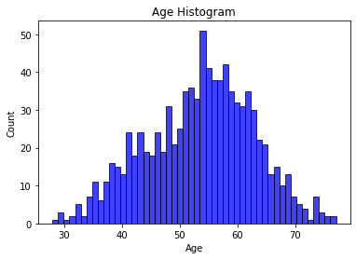
Histogram Plots-Age
The age histogram was broken out by each age that was in the study. From a quick glance, the data looks great and fairly normalized though it may be a bit skewed to the right just by looking at it.

Slide 6
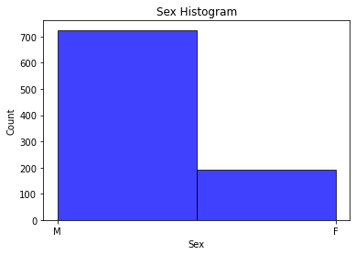
Sex Histogram
The sex histogram shows that this study was overwhelmingly filled by males. This is something to keep while conducting further data exploration. Having an imbalance between male and female may lead to inaccurate results when trying to predict the population.

Slide 7
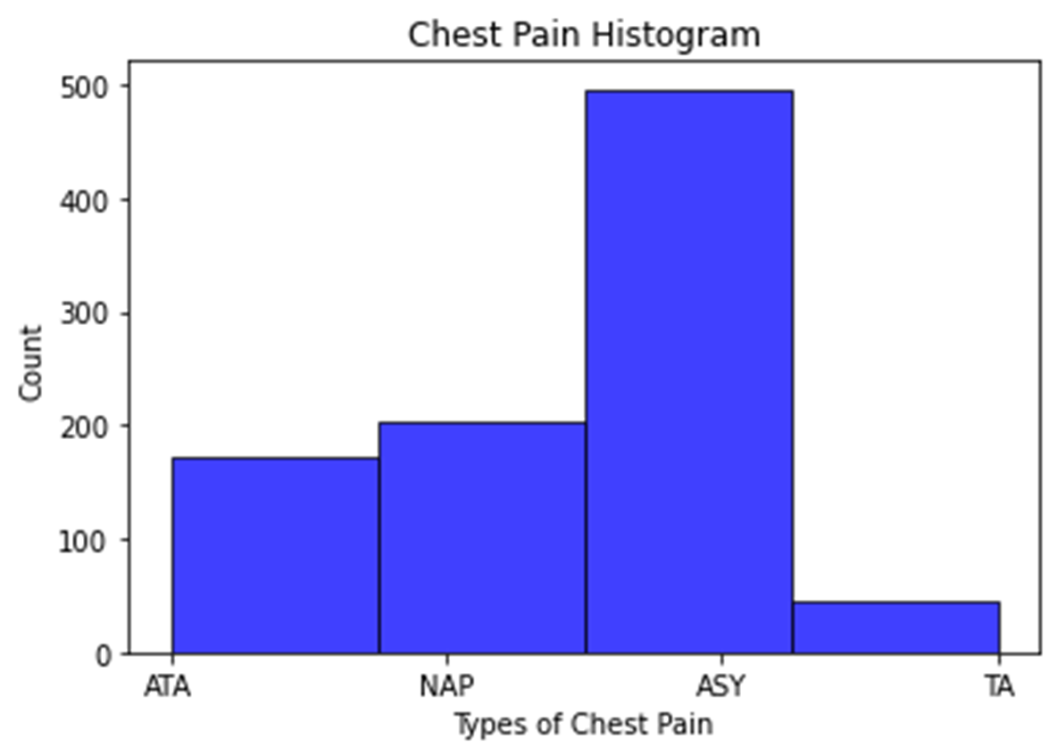
Chest Pain Histogram
The chest pain histogram data looks good. Just like the sex histogram, I need to keep in the back of my mind that ASY chest pain is a huge portion of the study. Additionally, TA chest pain isn’t well represented in the study. This can affect making predictions on the population.

Slide 8
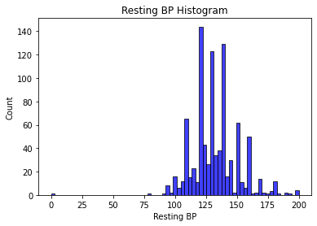
Resting BP Histogram
The resting blood pressure histogram shows that it has outliers. There are a few cases where the resting BP is at 0. Doing further research on resting BP shows that this is not possible unless the individual was dead. For that reason, I assume that it was either entered in incorrectly or the resting BP wasn’t measured for those individuals. Moving forward, I plan to change the zeros to NaNs and omit them during the data analysis phase.

Slide 9
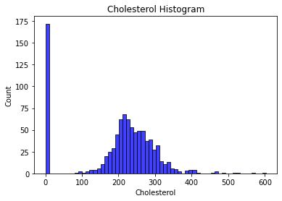
Cholestrol Histogram
The cholesterol histogram also shows outliers. The biggest outliers that are shown are at 0 and the ones close to 600. After conducting further research, it seems impossible to have a cholesterol level of 0. For that reason, I believe that these individuals didn’t get their cholesterol levels measured and the 0 is just a placeholder. I intend to replace the zeros with NaNs and omit those records from further analysis.

Slide 10
Descriptive Stats/Characteristics
Stats | Age | Resting BP | Cholesterol
Var | 89 | 324 | 3499
Mode | 54 | 120 | 254
Count | 918 | 917 | 746
Mean | 53.5 | 133 | 245
Std | 9.43 | 18 | 59.2
Min | 28 | 80 | 85
25% | 47 | 120 | 207
50% | 54 | 130 | 237
75% | 60 | 140 | 275
Max | 77 | 200 | 603
Stats | Sex | Chest Pain
Mode | M | ASY
Count | 918 | 918
Unique | 2 | 4
Top | M | ASY
Freq | 725 | 496

Slide 11
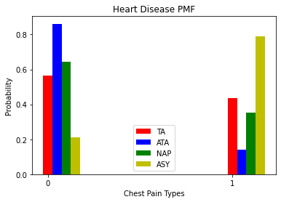
PMF- Heart Disease
For the PMF, I decided to focus on the chestPainType variable. As mentioned earlier in the slides, chestPainType is broken down into four different categories: TA, ATA, NAP, ASY. I compared each of the different categories to whether or not the individual has heart disease. 0 means that the individual didn’t have heart disease and 1 means that the individual had heart disease.
There were two categories that stood out to me. There was a real big difference in ATA and ASY. Those two categories seemed to act the opposite of each other. If individual has ATA, then there is over an 80% chance that they don’t have heart disease. However, if an individual has ASY there is almost an 80% chance they have heart disease.

Slide 12
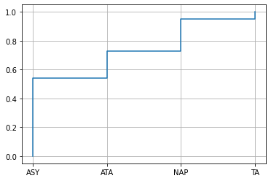
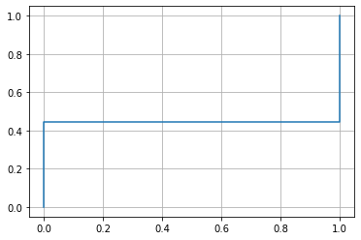
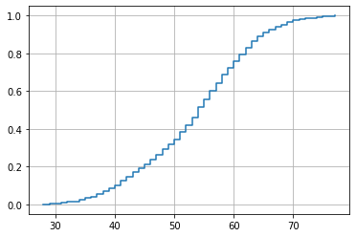
CDF
Chest Pain CDF
Heart Disease CDF
Age CDF
I decided to do three different CDFs to see what each variable would look like. I chose chest pain, heart disease, and age. The CDF maps a value to the corresponding percentile rank. The chest pain CDF shows that the ASY category in the chest pain variable has the biggest percentile compared to the other three. This matches with what the histogram showed earlier. This means that there are more ASY chest pains than the other types of chest pains.The heart disease CDF shows that there is a bigger percentile of individuals who have heart disease than not in this dataset. This should continue to reflect in the data analysis. The age CDF shows that there is a slightly bigger percentile of ages between 50 to 60 in the dataset. However, across the board, it looks like there is close equal representation. The CDF looks normalized to me.

Slide 13
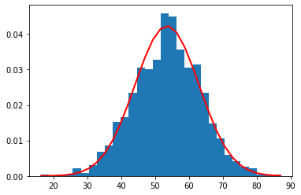
Analytic Distribution
For the analytic distribution, I decided to look at the normal distribution of the variable age. Looking at the red line, the age distribution looks to be normalized albeit with a slight skew on the left-hand side. This looks to be the case because of a couple young aged individuals in the dataset. It is good to know that the age variable has normal distribution because it shows that there is a good representation of age across the board in the study. It is one less variable that I need to worry about when it comes to affecting the results.

Slide 14
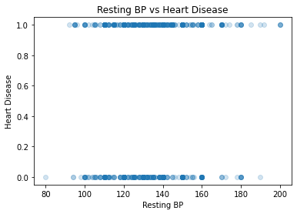
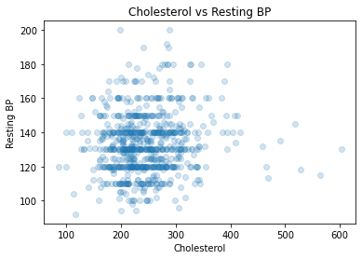
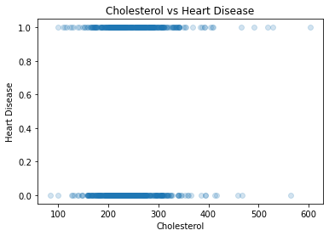
Scatterplots
I decided to include three different scatterplots to compare the different variables. I chose to compare Resting BP and Heart Disease, Cholesterol and Resting BP, and Cholesterol and Heart Disease.Looking at Resting BP and Heart Disease, the difference between having heart disease and not having heart disease was very small in regard to the resting BP. The range between the two of resting BP was very similar between heart disease and not heart disease. Looking at the cholesterol and Resting BP, you can see that there are several horizontal lines cutting across the resting BP. This probably means that resting BP was rounded when entered into the dataset. Additionally, it looks like most individuals are between 100 to 300 in cholesterol and 100 160 in resting BP.Looking at Cholesterol and Heart Disease, it is very similar to the Resting BP and Heart Disease scatterplot. Whether there is heart disease or not, the cholesterol levels fall around the same range between the two.

Slide 15
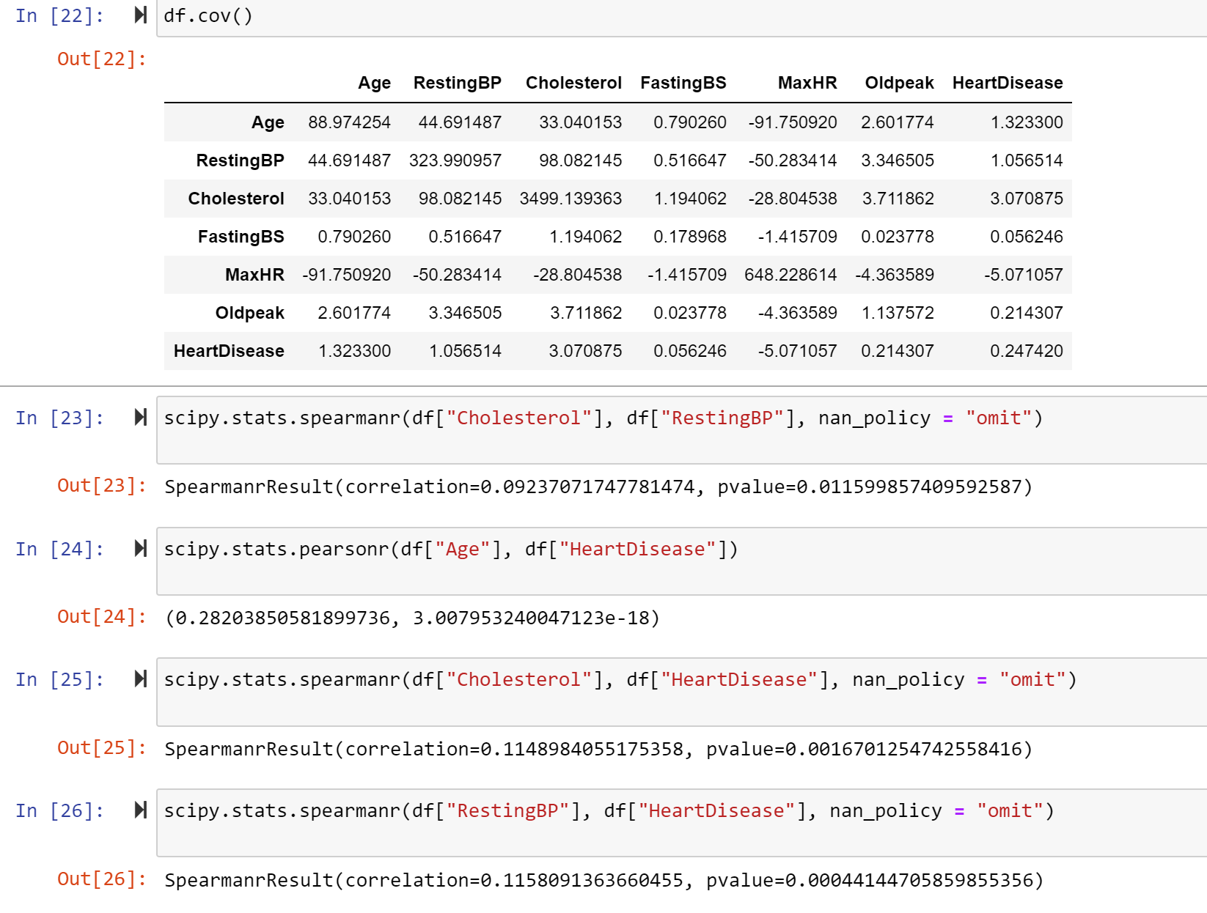
Covariance and Correlation
Looking at the covariance, resting BP and cholesterol have a positive covariance with Heart Disease. This means that restingBP and cholesterol both vary in the same direction as Heart Disease when it varies. The different correlation tests all came back statistically significant. The variable that had the biggest correlation with Heart Disease was Age. Cholesterol and RestingBP both had similar correlations to Heart Disease. Even though the correlation tests were statistically significant, the correlation numbers were small.

Slide 16
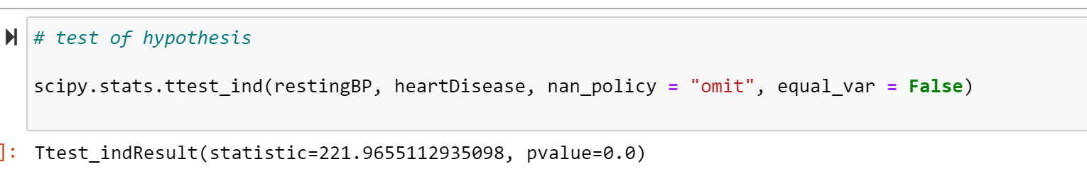
Hypothesis Test
I used the scipy module to conduct the hypothesis test. The null hypothesis was that regardless of the range of resting BP, there wouldn’t be a case of heart disease. After conducting the test, it received a p value of zero which is statistically significant. This means that the resting BP does have a factor in whether or not an individual has heart disease.

Slide 17
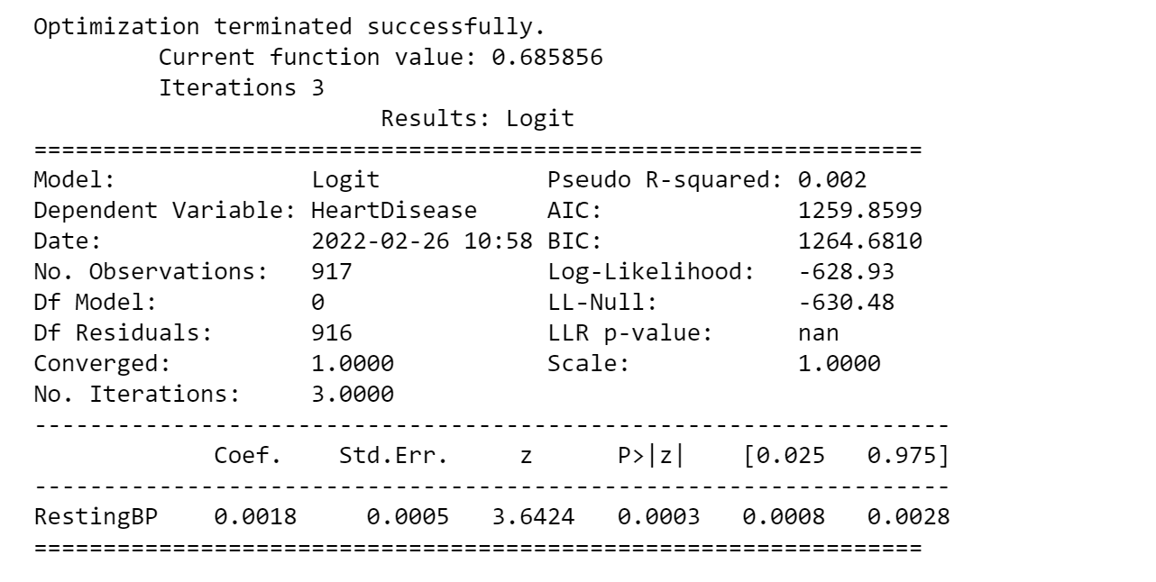
Regression Analysis
I ran a logistic regression model because my dependent variable, Heart Disease, is categorical. My independent variable was resting BP. Looking at the results, it is statistically significant because the p-value is 0.0003 which is less than 0.05. However, the pseudo R-squared is very close to zero which means that the logistic model is not a good fit to the data.

Slide 18
References
Discover Statistics Using R, Andy Field | Jeremy Miles | Zoe Field
R for Everyone, Jared P Lander
Think Stats, Allen B Downey
The data has been taken from www.kaggle.com
Link - https://www.kaggle.com/fedesoriano/heart-failure-prediction

